Slide 1
COLLEGE ADMISSION MANAGEMENT SYSTEM
CSI1007 – Software Engineering Principles Laboratory
By
Hemashree(23MID0092)
Disha(23MID0395)
Harini(23MID0345)
Simon Christina Beryl(23MIC0106)

Slide 2
Description of the project
The College Admission Management System will replace traditional, manual admission processes with a streamlined and automated online system. It will provide a seamless experience for students, administrators, and faculty by enabling online applications, document verification, merit list generation, fee payments, and real-time notifications. The system will integrate with existing college databases, ensuring smooth data management and reducing errors. It will enhance efficiency, improve communication, and support multi-user access while maintaining security and scalability.

Slide 3
Scope of the project
The College Admission Management System aims to automate the admission process, reducing manual workload and
improving efficiency. It allows students to apply online, upload documents, track application status, and make secure fee payments. The system generates merit lists, verifies documents, and sends automated notifications via email and SMS. It provides role-based access for students, administrators, and faculty while ensuring data security. Additionally, it supports multilanguage features, integrates with other college systems, and offers analytics for decision-making. The project focuses on creating a user-friendly, scalable, and efficient admission management platform for educational institutions.

Slide 4
IMPACT OF THE DEVELOPING PROJECT
Simplified Admission Process
The system automates application submission, document verification, and merit list generation, making the process smooth and hasslefree.
Increased Efficiency
By reducing manual tasks, the system ensures faster processing and better resource utilization.
Enhanced Transparency and Fairness
Admissions are handled systematically, ensuring unbiased selection and clear communication with applicants.
Improved Applicant Experience
Students benefit from an easy-to-use platform with real-time updates and notifications.

Slide 5
Cost and Resource Savings
Minimizing paperwork and manual errors lowers operational costs and improves sustainability.
Strengthened Data Security
The system ensures secure storage and processing of applicant data, maintaining privacy and trust.
Scalability for Growth
It accommodates increased application volumes, supporting the institution's expansion.
Better Decision-
Making Analytics and reports provide valuable insights for optimizing admission policies and course planning.

Slide 6

Technologies used in the project:
HTML (HyperText Markup Language)
HTML is the standard language used to create the structure of web pages.
It defines elements such as headings, paragraphs, tables, forms, and buttons for the admission system’s user interface.
CSS (Cascading Style Sheets)
CSS is used to style the web pages, making them visually appealing.
It helps in designing layouts, colors, fonts, and responsiveness to enhance the user experience.
PHP (Hypertext Preprocessor)
PHP is a server-side scripting language used for backend development.
It handles form submissions, processes student applications, connects to the database, and manages user authentication.
JavaScript
JavaScript is a client-side scripting language used to add interactivity to the website.
It validates user input in forms, updates content dynamically, and enhances the user experience without reloading the page.
SQL (Structured Query Language)
SQL is used to manage the database where student records, admission details, and user credentials are stored.
Queries are used to insert, update, retrieve, and delete data from the database efficiently.

Slide 7
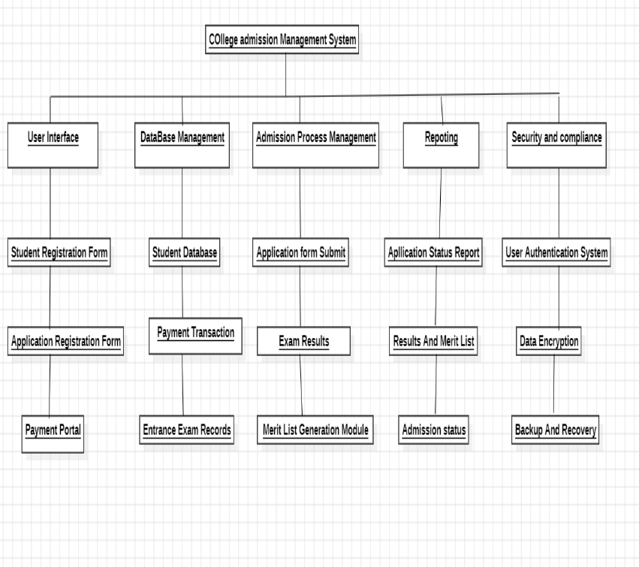
Work Breakdown Structure
Process -Based Work Breakdown Structure

Slide 8
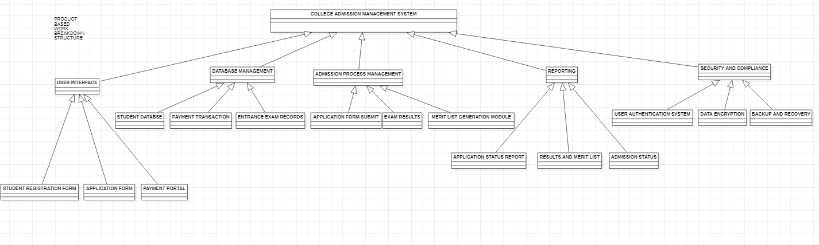
Product-Based Work Breakdown Structure

Slide 9
Functional Requirements
Simple and user-friendly interface for students, administrators, and faculty.
Responsive design for desktop and mobile access. Hardware Interfaces
Server specifications: 16 GB RAM, 4 CPUs, 500 GB SSD.
Database server to handle large volumes of student records.
Software Interfaces
Integration with payment gateways for online fee transactions.
Compatibility with college databases and student information systems.
Communications Interfaces
RESTful APIs for client-server communication.
Secure email and SMS gateways for notifications.

Slide 10
Non-Functional Requirements
Performance Requirements
Handle up to 10,000 concurrent users.
Process application submissions within 2 seconds.
Safety Requirements
Ensure student data privacy and compliance with data protection laws.
Secure document storage and access control for sensitive information.
Security Requirements
Use HTTPS for all communications.
Implement role-based access control (RBAC) for user authentication.
Encrypt sensitive data such as passwords and payment details.
Software Quality Attributes
Usability: Simple navigation and intuitive user interface.
Scalability: Support for increasing student applications over time.
Reliability: System uptime of 99.9% for uninterrupted access.
Maintainability: Easy updates and integration with new features.

Slide 11
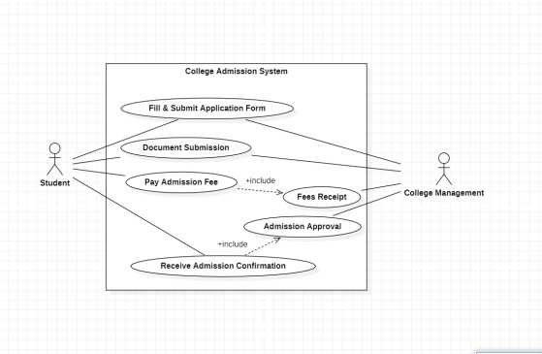
UML – Diagrams
use-case diagram

Slide 12
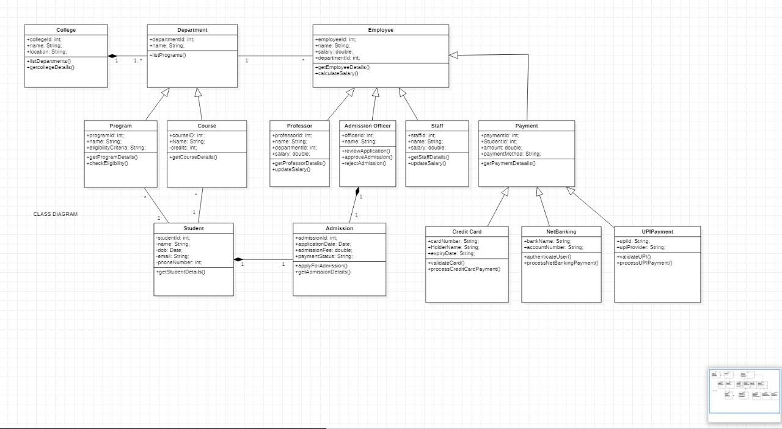
Class Diagram

Slide 13
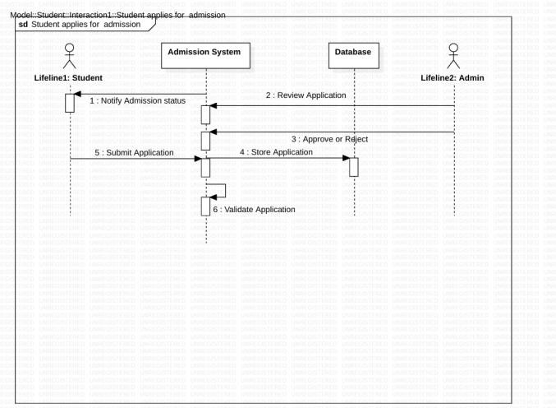
sequence diagram

Slide 14
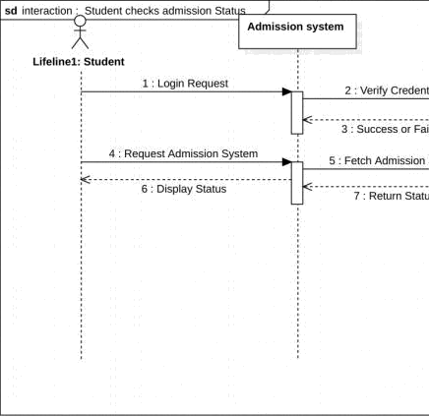

Slide 15
Testing
Case 1: Student Registration
Test Case ID: CAMS_TC_001
Test Scenario: Verify that a new student can successfully register for an account.
Test Case Description: The user must have a valid email ID and phone number. The system should be connected to the database. The registration page should be accessible.
Test Steps:
Navigate to the college admission portal.
Click on the “Register” button.
Enter the following details. Full Name Date of Birth Email ID Phone Number Password and Confirm Password.
Click the “Submit” Button.
Verify if a Confirmation email is received.
Click the verification link in the email.
Try logging in using registered credentials. Test Data:
Valid Case: (Username)
Name: John Doe

Slide 16
DOB: 10-05-2005
Email: johndoe@gmail.com Phone: 9876543210. Test Expected Result:
The Student should receive a confirmation email.
Clicking the verification link should activate the account.
The Student should be able to log in successfully. Actual Result:
Valid credentials: redirected to dashboard
Invalid credentials: got error message Pass/Fail: Pass.
CASE 2: Course Application & Document Upload
Test Case ID: CAMS_TC_002 Test Case Description:
The student must have a verified account.
The admission portal should be functional.

Slide 17
Required documents should be available in supported formats(PDF,JPG). Test Steps:
1.Log in to the admission portal.
Navigate to the “Apply for Admission” selection.
Select a course from the available list.
Fill the personal and academic details.
Upload the required documents:
High school certificate
Identity proof
Passport-size photo
Click “Submit Application”.
Verify that a confirmation message is displayed.
Check the email for an acknowledgment of the application
Test Data:
Course Selected: B.Tech in Computer Science
High School Certificate: HighSchoolcert.pdf(2MB)
ID Proof: AadharCard.jpg(500KB)
Photo: passport_photo.jpg(200KB)

Slide 18
Expected Result:
The application should be submitted successfully.
The system should display a confirmation message.
The student should receive a acknowledgment email.
Actual Result:
valid credentials: redirected to dashboard.
Invalid credentials: got error message. Pass/Fail: Pass.

Slide 19
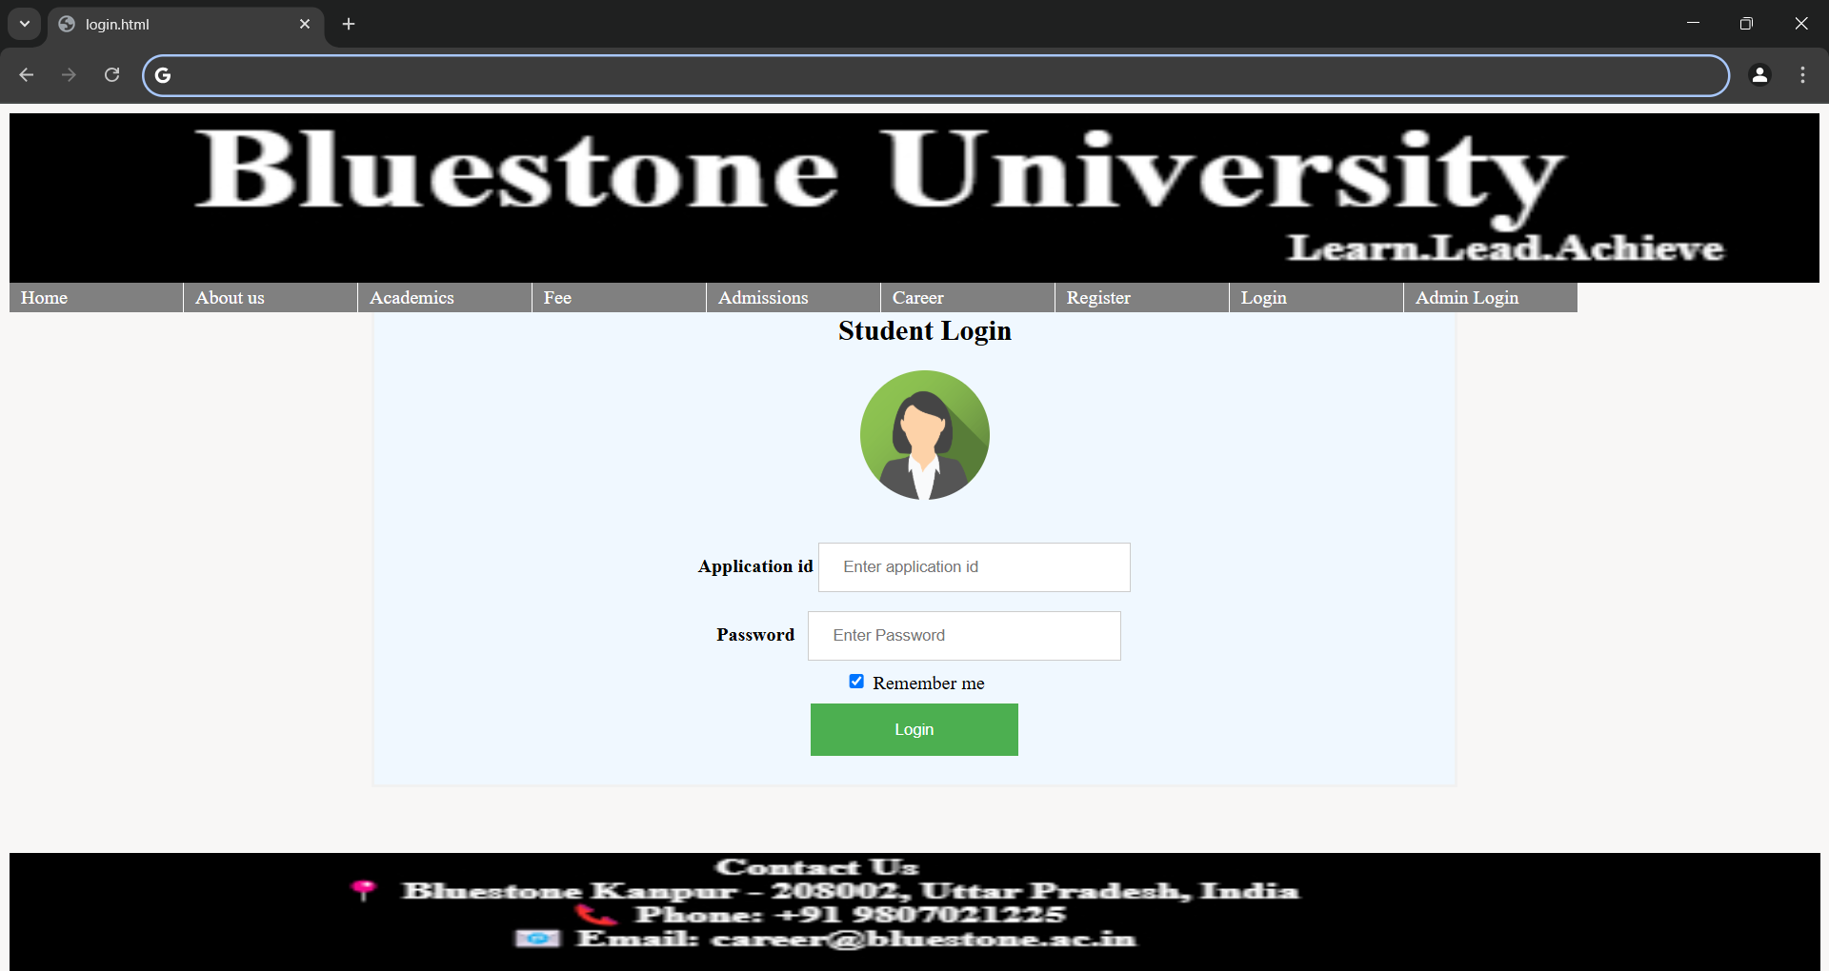
Project UI Screenshots

Slide 20
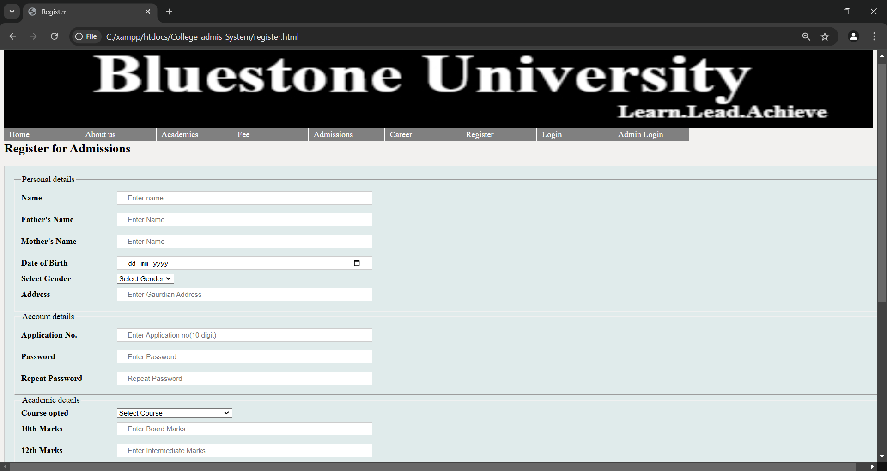
Project UI screenshot

Slide 21
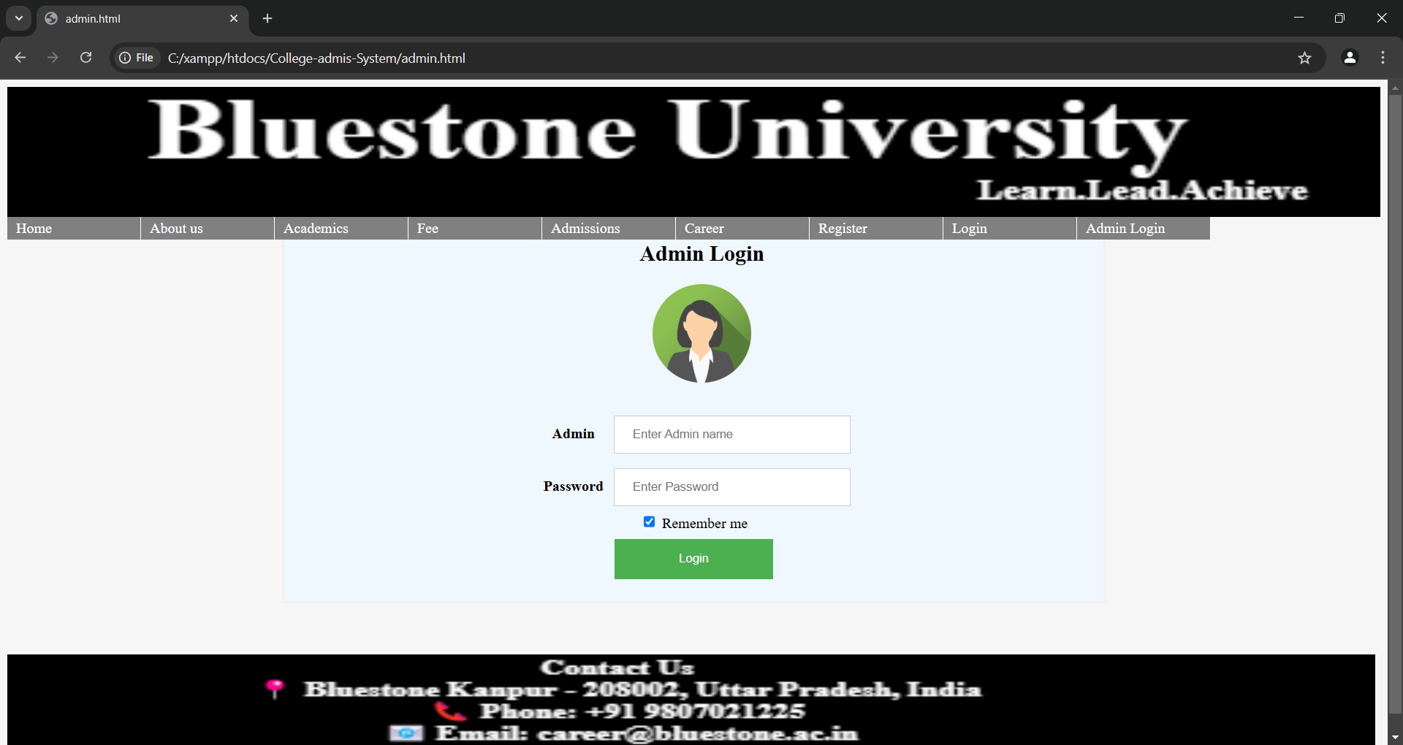
Project UI screenshot

